Slide 1
Memory Management

Slide 2
Memory
CPU can only access content from main memory and registers (built into processor)
Data / instruction can not be read from secondary storage by processor . It needs to be moved from secondary storage to main memory.

Slide 3
Memory Management
Three design constraints of memory subsystem
Size
Speed
Cost
Across the spectrum of the technologies following relationship holds
Smaller access time , greater cost per bit
Greater capacity, smaller cost per bit
Greater capacity , greater access time
Memory subsystem requirement
Large capacity, fast access time and low cost

Slide 4
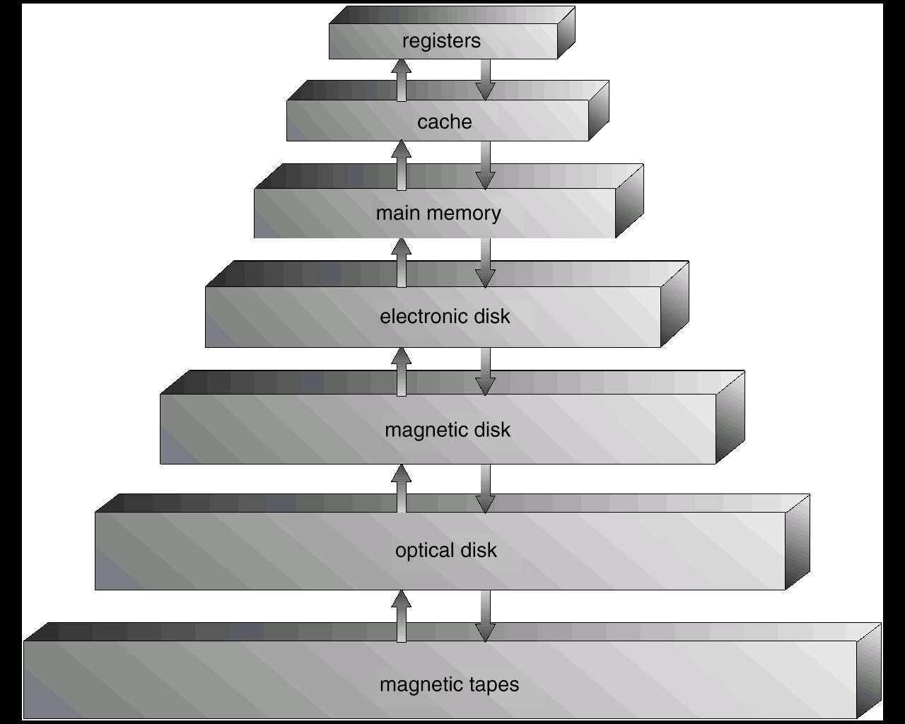
To meet the contradictory design requirement , organize memory in hierarchical manner

Slide 5
As one goes down the Hierarchy , the following conditions occur:
Decreasing cost per bit
Increasing capacity
Increasing access time
Decreasing frequency of access of the memory .

Slide 6
Example (two level memory)
Processor has access to two level of memory
Level 1 contains 1000 words and access time(T1) is 0.1 Micro second
Level 2 contains 100,000 words and access time (T2) is 1 Micro second
If the word is found in level 1
then it is accessed in 0.1 Micro sec
else 1.1 micro sec

Slide 7
T1+T2
T2
T1
Fraction of access involving only level 1
1
0

Slide 8
Observations
We observe that if memory access at level 2 is less frequent then overall access time is close to level 1 access time
The basis for validity of this condition is a principal known as locality of reference
During course of execution of program , memory references for both data and instruction tends to cluster

Slide 9
Memory Management Requirement
Relocation
Protection
Sharing
Logical organization
Physical organization

Slide 10
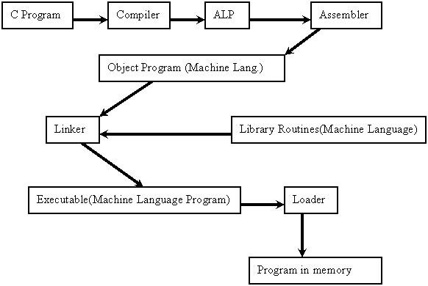

Slide 11
Binding of Instructions and Data to Memory
Address binding of instructions and data to memory addresses can happen at three different stages.
Compile time: If memory location known a priori, (starting location) absolute code can be generated; must recompile code if starting location changes. Example MS DOS .COM format programs.
Load time: Must generate relocatable code if memory location is not known at compile time. Final binding is delayed until load time. If the staring address only changed then we need to reload the user code to incorporate the changed value.
Execution time: Binding delayed until run time if the process can be moved during its execution from one memory segment to another. Need hardware support for address maps (e.g., base and limit registers). Most general purpose operating systems use this method.

Slide 12
Loading Program into main memory
it is assumed that OS occupies some fixed portion of memory and rest is available to user processes.
Based on requirement and functionality different memory management methods are adopted.
Should the process be allocated memory in contiguous manner?
How the User program / data area is managed?
Static/dynamic partitioning
Equal /unequal partition

Slide 13
Fixed Partitioning
Main memory is divided into number of fixed size partition at system generation time.
A processes can be loaded into a partition of equal or greater size

Slide 14
Equal size fixed Partition
Easy to implement
If total user memory space is X and size of partition is Y, ( Y< X) then number of partitions in system will be X / Y. This is the maximum number of processes that can be loaded in the memory at any given time
If program size is much smaller than the size of partition, the remaining space is unutilized
A program may be too big to fit into a partition

Slide 15
Overlays
Needed when process is larger than amount of memory allocated to it.
Keep in memory only those instructions and data that are needed at any given time
Implemented by user, no special support needed from operating system, programming of overlay structure is complex

Slide 16
Overlay cont..
Symbol table (20 K)
Common routine (30 K)
Overlay driver (10 K)
Pass 1 (70 K)
Pass 2 (80 K)

Slide 17
Unequal size partition
We create fixed number of unequal size partition
Program is loaded into best fit partition
processes are assigned in such a way as to minimize wasted memory within a partition
queue for each partition

Slide 18
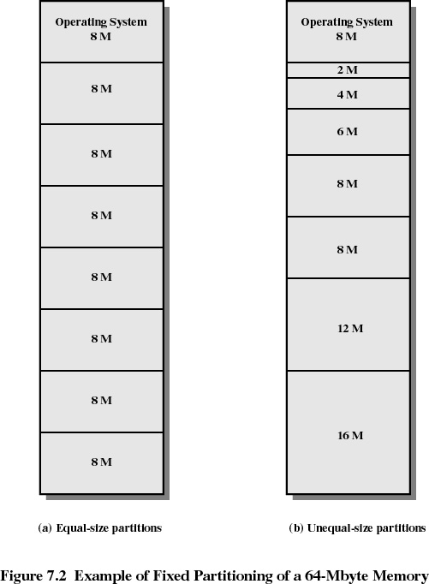

Slide 19
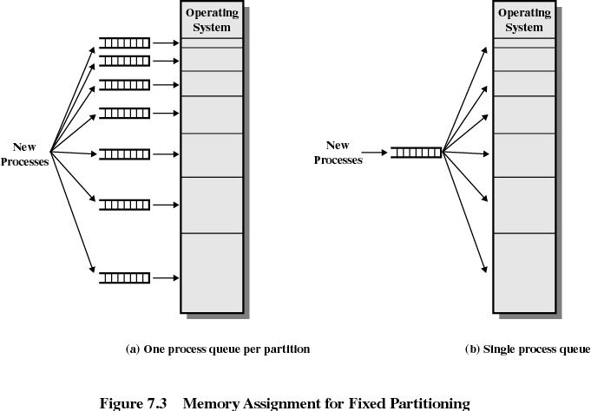

Slide 20
Dynamic Partitioning
Partitions are of variable length and number
Process is allocated exactly as much memory as required
Eventually we get holes in the memory. This is called external fragmentation
Must use compaction to shift processes so they are contiguous and all free memory is in one block

Slide 21
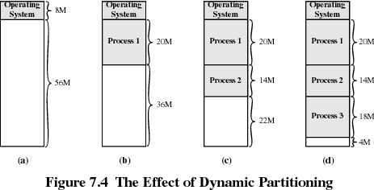

Slide 22
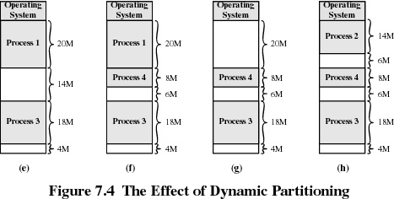

Slide 23
How to satisfy a request of size n from a list of free holes.
First-fit: Allocate the first hole that is big enough
Fastest
May have many process loaded in the front end of memory that must be searched over when trying to find a free block

Slide 24
Next-fit
More often allocate a block of memory at the end of memory where the largest block is found
The largest block of memory is broken up into smaller blocks
Best-fit Allocate the smallest hole that is big enough; must search entire list, unless ordered by size. Produces the smallest leftover hole
Compaction is required to obtain a large block at the end of memory
Since smallest block is found for process, the smallest amount of fragmentation is left memory compaction must be done more often

Slide 25
Worst-fit: Allocate the largest hole; must also search entire list. Produces the largest leftover hole.
First-fit , next-fit and best-fit perform better than worst-fit in terms of speed and storage utilization.

Slide 26
Buddy System
In Buddy system memory blocks are available of size 2^{K} where L<= K<= U
Entire space available is treated as a single block of 2^{U}
If a request of size s such that 2^{U-1} < s <= 2^{U}, entire block is allocated
Otherwise block is split into two equal buddies
Process continues until smallest block greater than or equal to s is generated
Buddy system is compromise to overcome the shortcoming of fixed and variable partitioning scheme

Slide 27
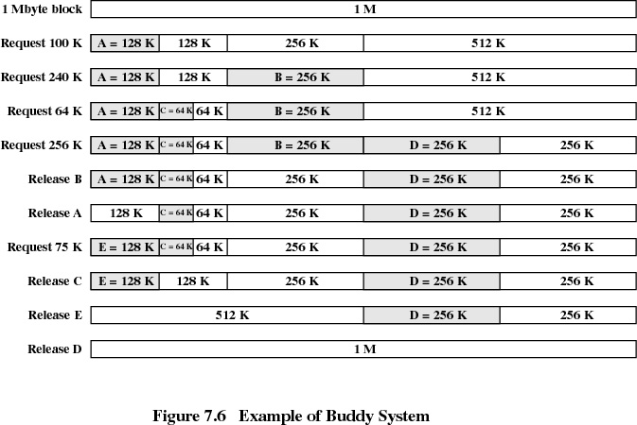

Slide 28
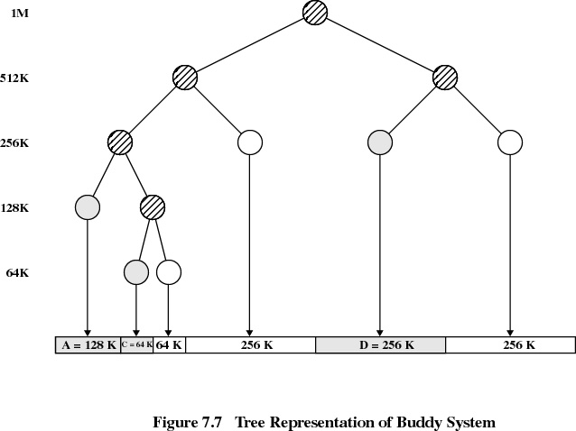

Slide 29
Fragmentation
External fragmentation –memory space exists to satisfy a request, but it is not contiguous.
Internal fragmentation – allocated memory may be slightly larger than requested memory; The additional space is unused
50 % rule. ( N allocated block & 0.5N waste)
Reduce external fragmentation by compaction
Compaction is possible only if relocation is dynamic, and is done at execution time.
I/O problem
Latch job in memory while it is involved in I/O.
Do I/O only into OS buffers

Slide 30
Allocate total required amount of memory
Allocate memory in contiguous manner

Slide 31
We realize that loading entire program in memory is wasteful as all the functionality of a program is not used simultaneously.
Can We load on Demand ?
In this case when the additional code is brought in memory the memory may not be available in contiguous manner
Relax the assumption of contiguous memory allocation

Slide 32
With Load on demand and Discontiguous allocation, we require
logical address to physical address mapping
Memory can be allocated in fixed size chunks
Or it can be allocated in variable size chunks

Slide 33
Memory allocation Problems
Internal fragmentation (fixed Partition)
External fragmentation (variable Partition)
Compaction
Contiguous allocation
The system may not have enough memory to hold complete program( Overlaying technique required)

Slide 34
Dynamic Partitioning (paging)
Memory is dynamically partitioned at run time and is allocated to processes
Logical address : is a reference to memory location independent of current assignment of data to memory
The logical address space is divided into fixed size small chunks (usually 256 KB to 4 MB ) known as page
The Physical memory is also divided into fixed size chunk and are known as frames.
The size of frame and page is always equal for a given system
The frame and page size are always power of 2. Mainly for easy address computation

Slide 35
When process pages are required to be loaded into system , OS allocates required number of frames where process pages are loaded.
Frame need not be allocated in contiguous manner
If we have a process of size 13KB and page size is 4KB then process is allocated 4 frames .
Internal fragmentation occurs (18% unused space It is less sever as compared to fixed partitioning )

Slide 36
Logical to Physical Address Mapping
Page 0
Page 1
Page 2
Page 3
Page n
Frame 0
frame 1
Frame 2
Frame 3
Frame m
Physical Address
Logical Address

Slide 37
Address Translation Example and Issues
Consider 80X86 Processor
Byte organized Memory
32 Bit IP (logical address space 4GB)
Address lines 32 (maximum Physical Memory 4 GB)
Page size 4KB

Slide 38
Logical Address
31
11
2
1
0
Page Number
offset
Logical address is divided into two parts , 12 bit offset within a page and 20 bit
page number
This logical address is translated to 32 Bit Physical address consisting of 12 bit
Offset and 20 bit frame number
The address translation is the job of Memory management unit (MMU) Hardware

Slide 39
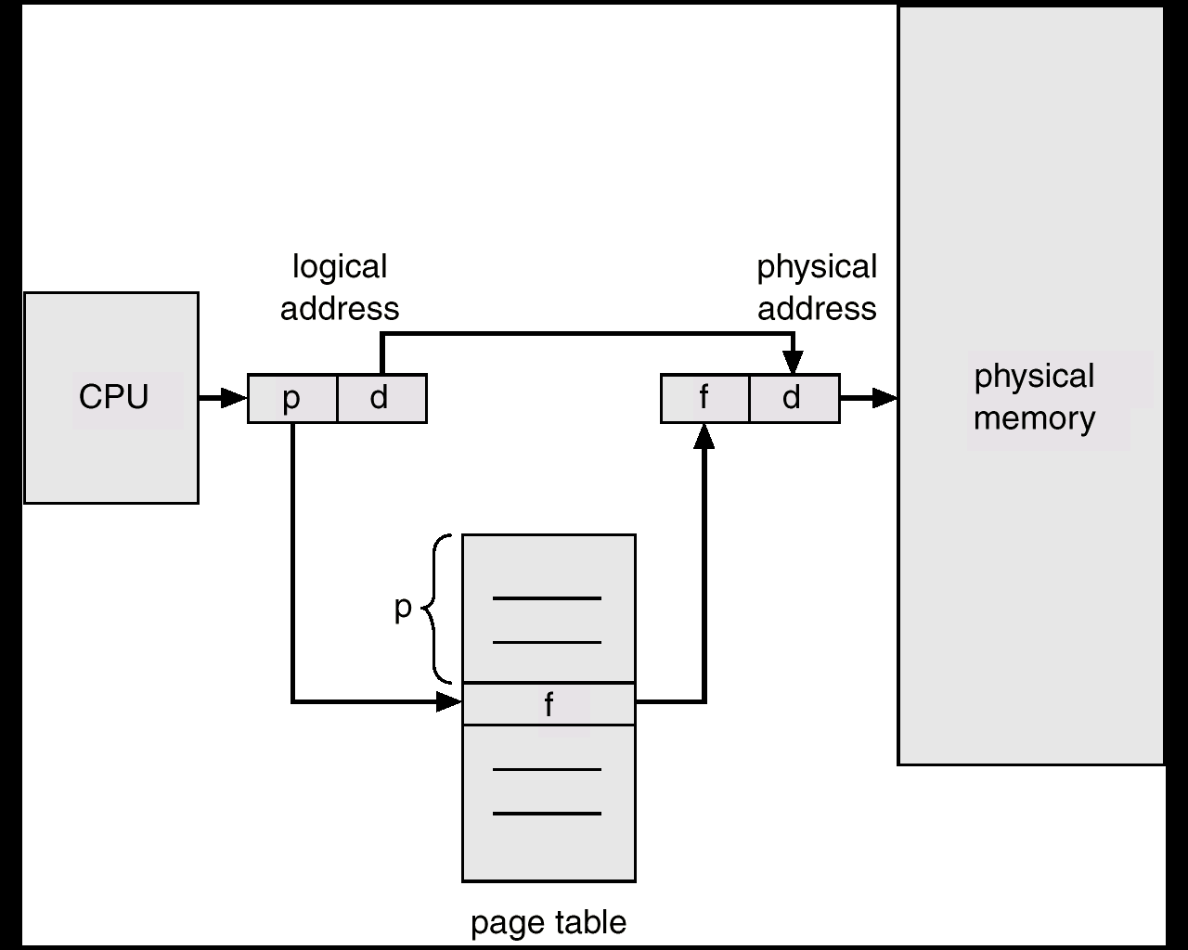
Address Translation Architecture

Slide 40
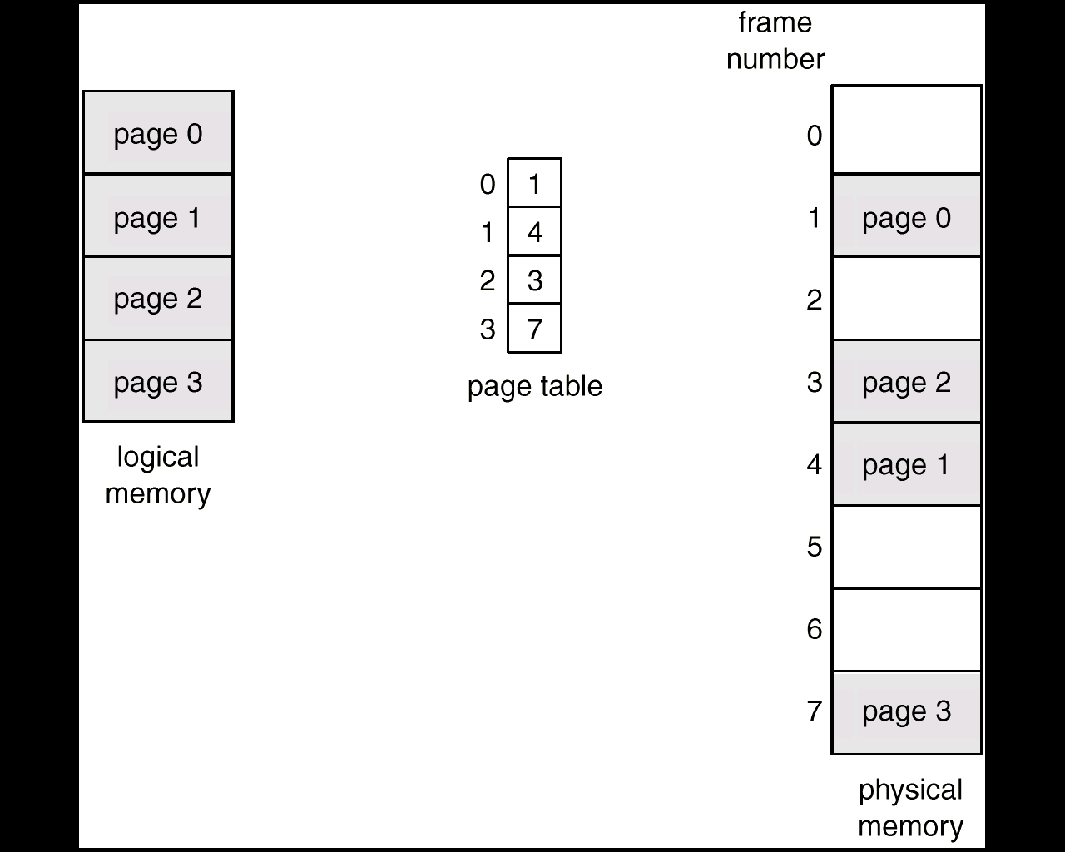
Paging Example

Slide 41
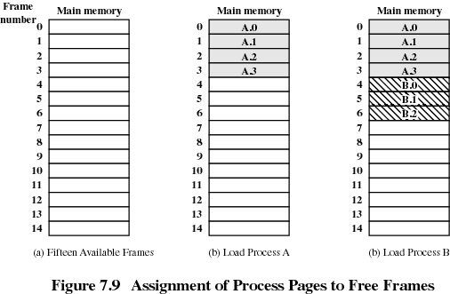

Slide 42
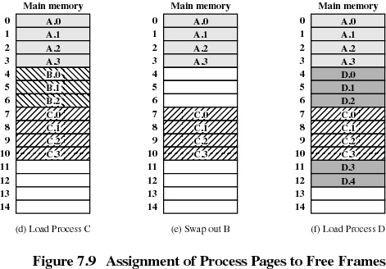

Slide 43
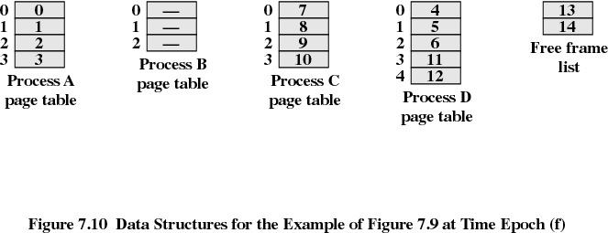

Slide 44
Memory management
We have learnt
What is memory & types of memory
Memory partitioning
Memory management techniques
Paging
Segmentation

Slide 45
Paging (contd)
Internal fragmentation results
To reduce internal fragmentation we need to reduce the page size.
If page size is small there will be an overhead of page table entry.
Page sizes now in use are typically between 4KB and 8KB.
Some CPU and kernel supports multiple page sizes. Example : Solaris 8KB and 4MB pages
Main advantage of paging is the separation of user view of memory & actual physical memory.
User process cannot access memory outside of its page table.

Slide 46
Implementation Issues
Where does page table resides in memory ?
What is the minimum number of frame that can be allocated?
How to reduce page table size?

Slide 47
Logical Address
31
11
2
1
0
Page Number
offset
Logical address is divided into two parts , 12 bit offset within a page and 20 bit
page number
This logical address is translated to 32 Bit Physical address consisting of 12 bit
Offset and 20 bit frame number
For mapping the logical to physical address, we would require a minimum of 20 bit for
Page no and 20 bit for frame number . A total of minimum 40 bits .

Slide 48
Page Table
Page Number (20 bit )
Frame Number (20 Bit)
12
17
13
15
20
23

Slide 49
Page table design issue
Since we have 20 bits for page number the total number of pages supported by system will be 2²⁰ = 1 M
Since each page table entry is 40 bit (5 byte), we may require a total of 5 MB space per process
Issue is how to reduce size of page table

Slide 50
Page table size reduction
Treat page number as an index to an array containing frame number.
This will require that we would need to store only 20 bit for an entry resulting in 50% memory reduction
Multi level page table

Slide 51
A set of pages can be grouped together to form a page group
We can divide the 20 bit used for page number in 10 + 10 Bit.
10 bit for specifying page group and 10 bit for page number within page group
0
1
2²⁰
Page Group 1
Page Group 2
Page Group m

Slide 52
Logical Address
31
21
11
2
1
0
Page dir
Page table
offset
Logical address is divided into two parts , 12 bit offset within a page and 20 bit
page number
This logical address is translated to 32 Bit Physical address consisting of 12 bit
Offset and 20 bit frame number
For mapping the logical to physical address, we would require a minimum of 20 bit for
Page no and 20 bit for frame number . A total of minimum 40 bits .

Slide 53
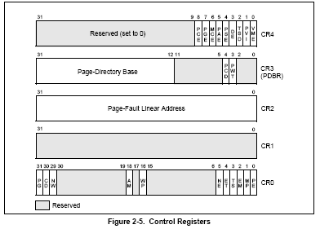
Support for paging on Intel processors

Slide 54
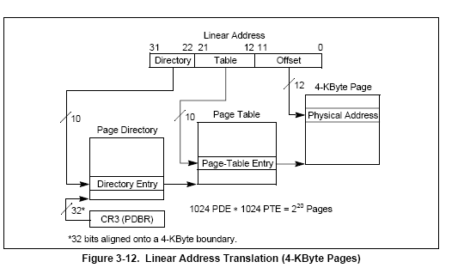

Slide 57
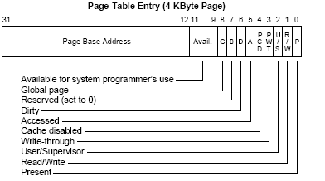

Slide 58
Associative Register
The two memory access problem can be solved by the use of a special fast-lookup hardware cache called associative registers or translation look-aside buffers (TLBs)
Associative registers – parallel search
Address translation (A´, A´´)
If A´ is in associative register, get frame # out.
Otherwise get frame # from page table in memory
Page #
Frame #

Slide 59
Effective Access Time
Example
Hit ratio 80%
20 nsec to search in TLB
100 nsec to access Memory
Effective Memory Access Time
(E M A T) = (0.80 X 120) + (0.20 X 220) = 140 nsec
If hit ratio is 98% then
EAT = (0.98 X 120) + (0.02 X 220) = 122 nsec

Slide 60
Segmentation
Memory-management scheme that supports user view of memory. (User’s view of memory is not same as physical memory.)
A logical address space is a collection of segments.
A program is a collection of segments. A segment is a logical unit such as:
main program,
procedure,
function,
local variables, global variables,
common block,
stack,
symbol table, arrays
Address : segment : offset ( segment no, offset)

Slide 61
Logical View of Segmentation
1
1
4
2
3
4
2
3
user space
physical memory space

Slide 62
s
Limit
Base
CPU
Physical
Memory
Segment table
S d
<
+
Trap; addressing error

Slide 63
Segmentation Architecture
Segment table – maps two-dimensional physical addresses; each table entry has:
base – contains the starting physical address where the segments reside in memory.
limit – specifies the length of the segment.
Segment-table base register (STBR) points to the segment table’s location in memory.
Segment-table length register (STLR) indicates number of segments used by a program;
segment number s is legal if s < STLR.

Slide 64
Seg 0
Seg 3
Seg 2
Seg 4
Seg 1
1400
2400
Seg 0
 | Limit | Base
0 | 1000 | 1400
1 | 400 | 6300
2 | 400 | 4300
3 | 1100 | 3200
4 | 1000 | 4700
3200
Seg 1
Seg 3
4300
Seg 4
4700
Seg 2
5700
6300
6700

Slide 65
Segmentation Architecture (Cont.)
Relocation.
dynamic
by segment table
Sharing.
shared segments
same segment number
Allocation.
first fit/best fit
external fragmentation

Slide 66
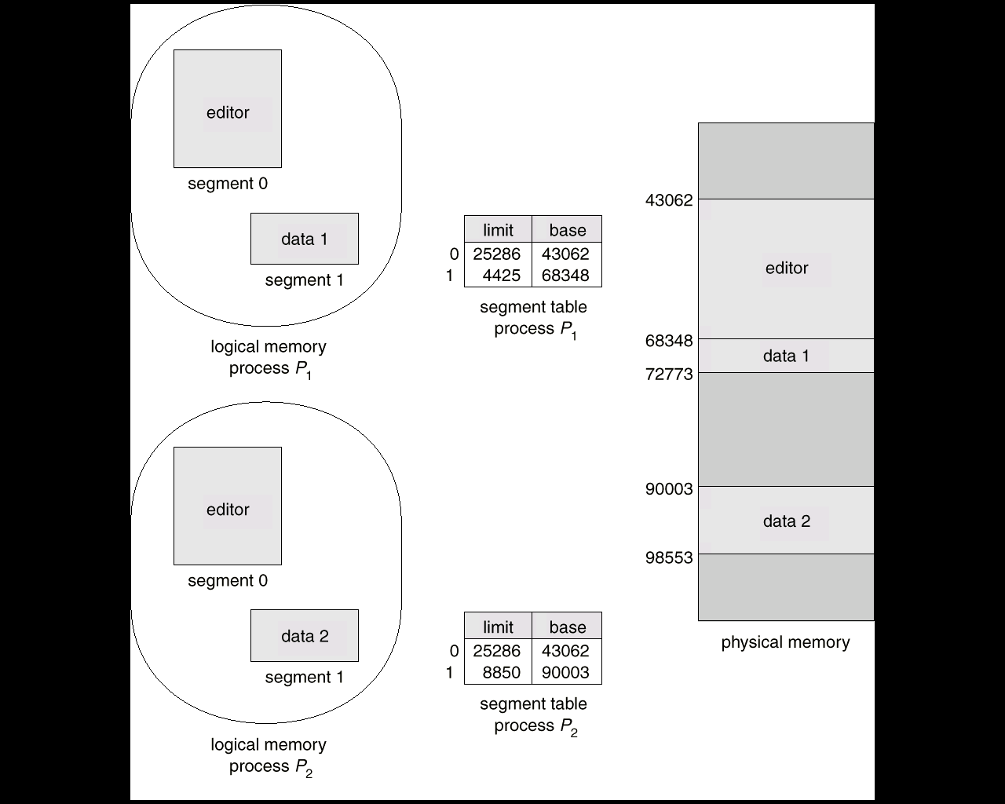
Sharing of segments

Slide 67
Segmentation In 80X86 Processor
Address is specified as Segment : Offset
X86 Processor has Several segment registers
CS (code segment)
DS (Data Segment)
SS (Stack segment )
ES (Extra segment)
GS & FS segment

Slide 69
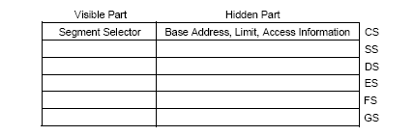

Slide 70
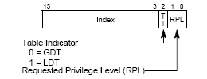

Slide 71
Memory Management Registers
Processor provides 4 memory management registers :
GDTR Global descriptor table register
LDTR Local Descriptor Table register
IDTR Interrupt descriptor Table register
TR Task register
These registers specify the location of data structure which control segmented memory management

Slide 73
GDTR Register
GDTR Holds
32 Bit Base address of GDT
16 bit limit value , defining size of GDT
On Power up/reset, Base part is set to 0 and limit is set to FFFFH
Each entry of GDT is of 8 bytes
LGDT, SGDT instruction can be used to load / store GDTR

Slide 74
IDTR Register
IDTR Holds
32 Bit Base address of IDT
16 bit limit value , defining size of IDT
On Power up/reset, Base part is set to 0 and limit is set to FFFFH
Each entry of IDT is of 8 bytes
LIDT, SIDT instruction can be used to load / store IDTR

Slide 75
LDTR Register
LDTR Holds
32 Bit Base address of LDT
16 bit limit value , defining size of LDT
Attribute for descriptor table
On Power up/reset, Base part is set to 0 and limit is set to FFFFH
Each entry of LDT is of 8 bytes
LIDT, SIDT instruction can be used to load / store IDTR

Slide 76
Logical Address to linear address Translation

Slide 77
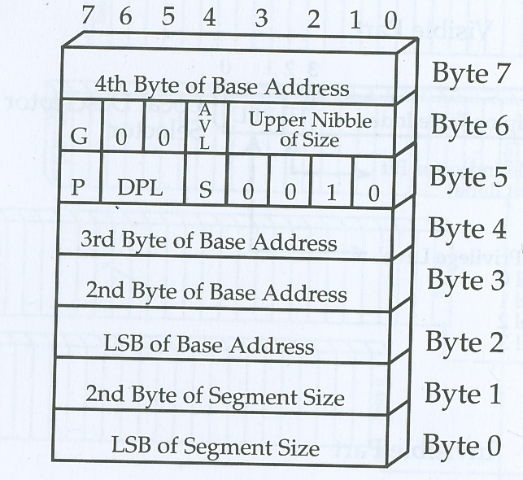
General Format for Descriptor table Entry

Slide 78
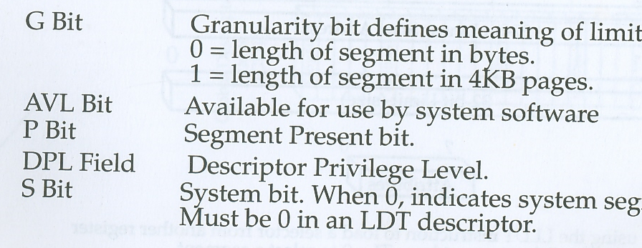

Slide 79
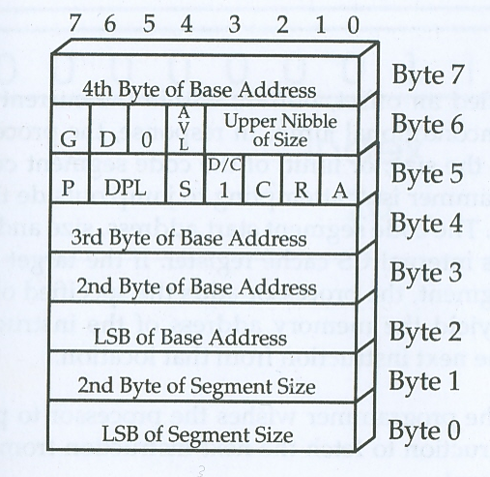
Code segment descriptor

Slide 80
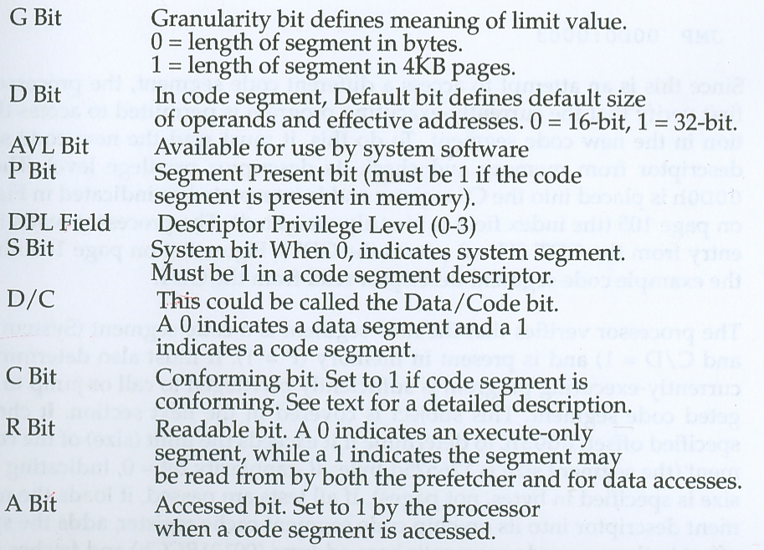

Slide 81
Code segment with C= 0 is non conformong
Non conforming segment can only be jumped to or called by program whose CPL matches with Target code DPL
Conforming code can be jumped to or called by program whose CPL is less privileged than segment DPL

Slide 82
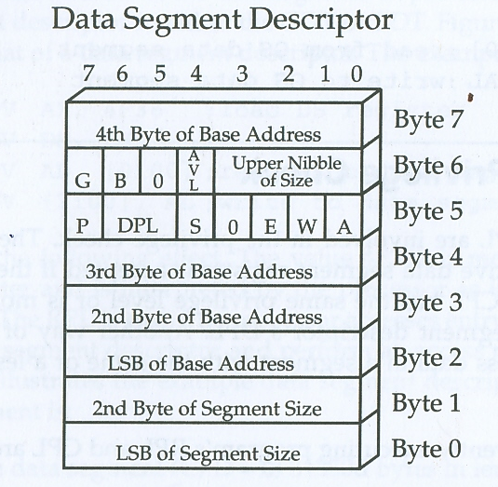

Slide 83
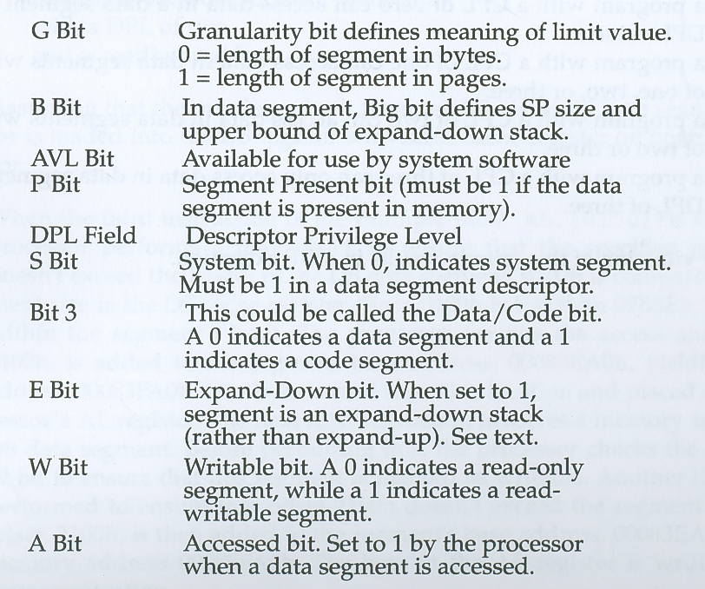

Slide 84
Expand Up
BOS= base address
TOS =Base +limit
Expand down
BOS= Base +(limit -1)
TOS=Base +ffff or FFFFFFFF

Slide 85
Protection Ring

